Slide 1
Knossos
Lynette Crews
Notes:
stuff

Slide 2

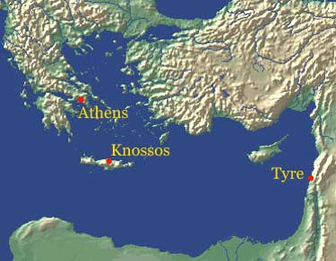
History
Also spelled: Cnossus
Ancient city in Crete
Neolitihic settlement : settled around7000 BC
Minoans
Mythical King Minos
Served as capital
Later ruled by the Mycenaeans until 1375 BC.
abandoned after its destruction
Notes:
Europe’s oldest city

Slide 3
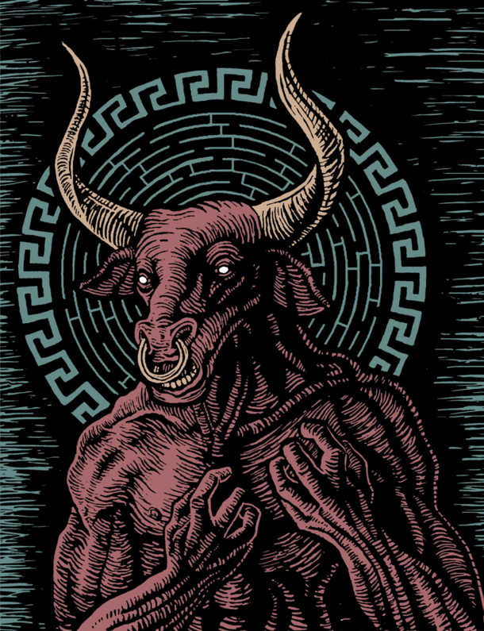
History (And myth)
Knossos is connected to many ancient Greek myths
King Minos
The Labyrinth and The Minotaur
Daedalus and Icarus

Slide 4
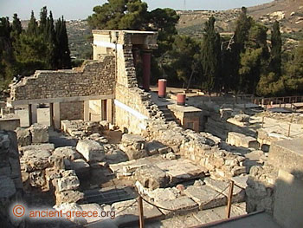
Palaces
Palace
First palace
Built c. 1900 BC
destroyed c 1700 BC
Second palace
built on the ruins of the old one. partially destroyed about 1450BC
Current palace
“Picture of Knossos Palace.
Looking NE towards the Hypostyle Hall (or Customs House)”
Notes:
Middle Minoan period (2000–1580 BC)
Destroyed earthquake or foreign invaders.
Built grander with more
elaborate system of drains, conduits, and pipes provided water and sanitation for the palace
450BC, after which the Mycenaeans established themselves at Knossos

Slide 5
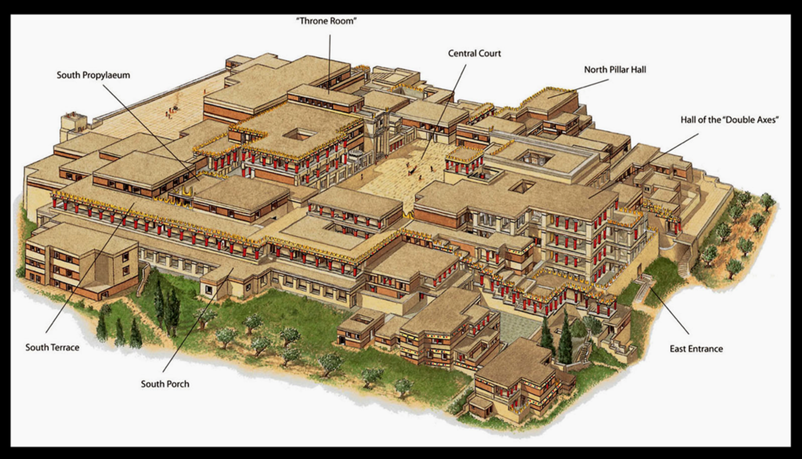

Slide 6
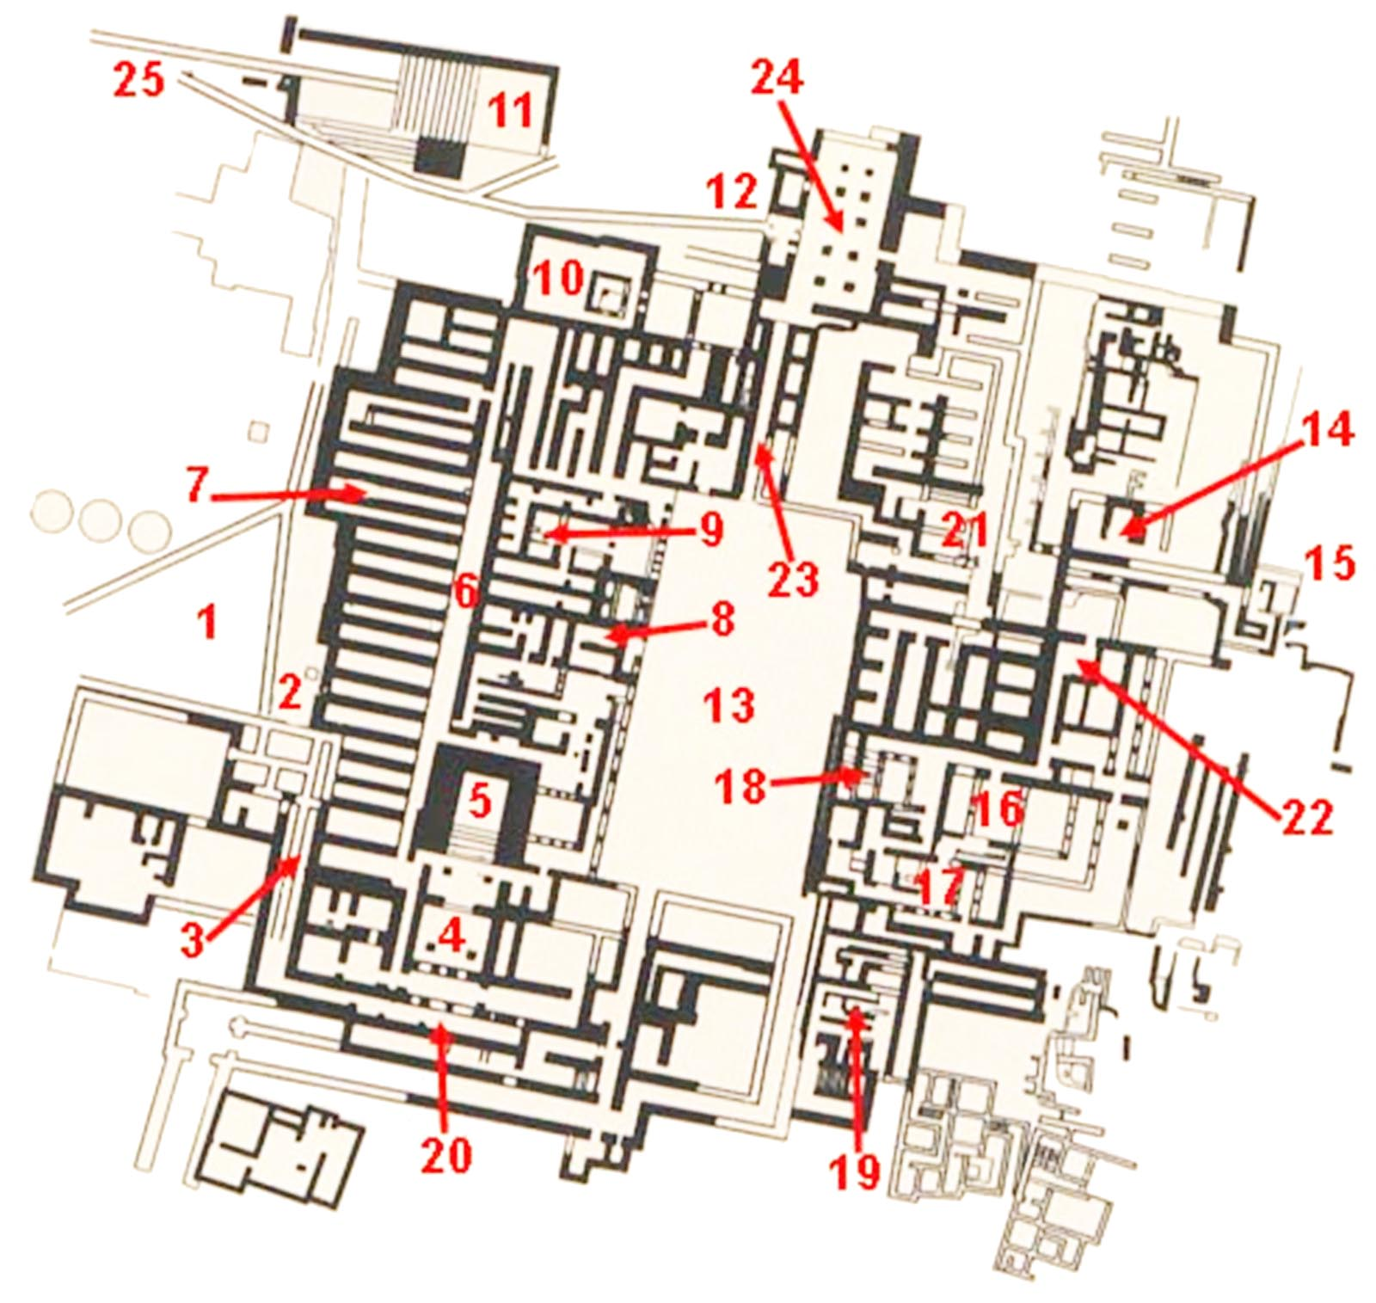
1. West Court.
2. West Gate. (Entrance)
3. Corridor of the Procession.
4. Propylaea.
5. Staircase.
6. Storage Rooms Corridor.
7. Warehouses.
8. Sanctuary.
9. Throne Room.
10. Lustral basin.
11. Open Air Theatre.
12. North Entrance.
13. Central Court.
14. Pot Storehouses.
15. East Bastion
16. Double axe room.
17. Queen Apartment.
18. Grand Staircase.
19. Small Sanctuary with double axes.
20. South Entrance.
21. Draughtboard corridor.
22. Workshops.
23, 24. Customs Office.
25. Paved Road.

Slide 7
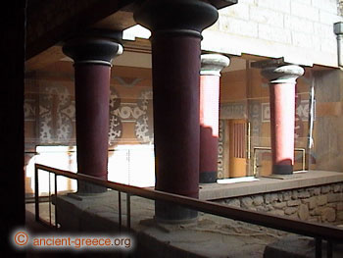
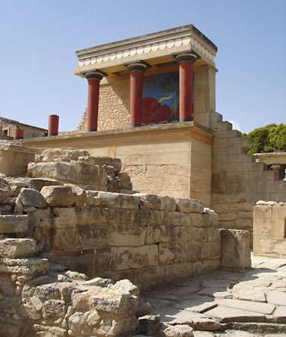

Slide 8
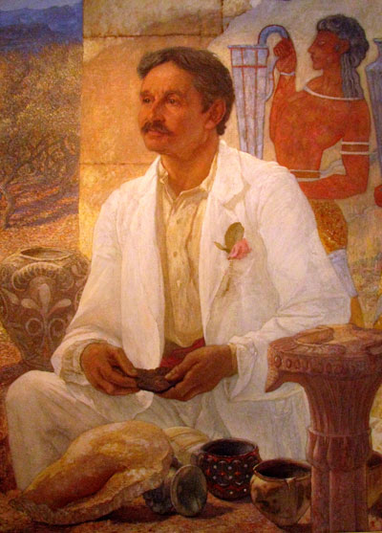
Excavation History
Minos Kalokairinos
Wealthy family
Began Excavating in 1878
Sir Arthur Evans
British archeologist
Excavations
1900-1913
1922-1930
Scrutinized for his excavation techniques
Notes:
British archeologist
unique light reflected from the surfaces. This is attributed to the extensive use of mineral gypsum (selenite)/ used cement in his restoration work, covering the selenite walls with it, a restoration technique that removed the light reflection and poses risk of further damage

Slide 9
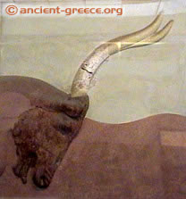
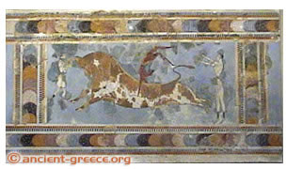
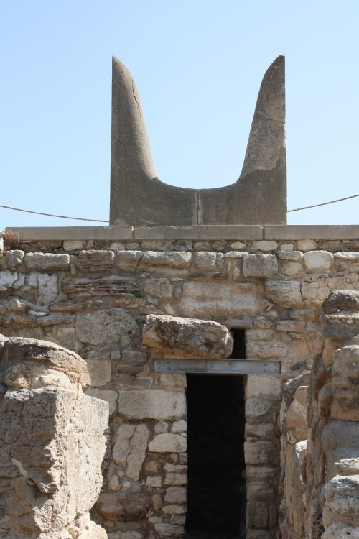
Frescos at the palace at Knossos
Notes:
. Minoan Horns of Consecration

Slide 10
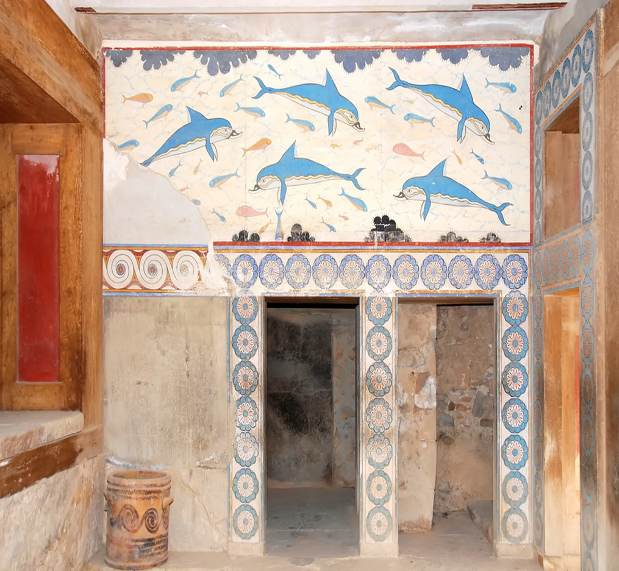
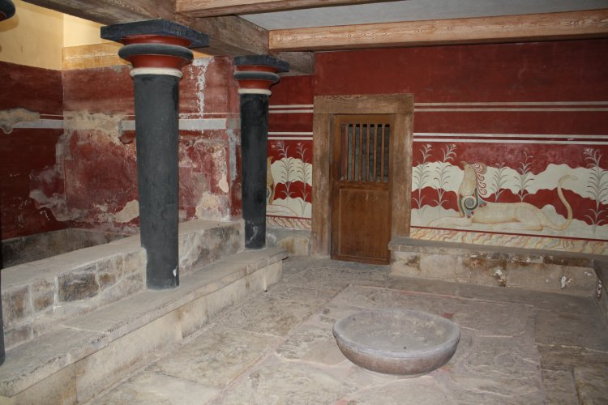
Notes:
griffin fresco-throne room
The queen's megaron at the Palace of Knossos features a reconstructed fresco depicting blue dolphins swimming above a doorway

Slide 11
Citations
https://www.heraklion.gr/en/ourplace/knossos/knossos.html
https://www.livescience.com/27955-knossos-palace-of-the-minoans.html
https://www.britannica.com/place/Knossos
https://www.ancient.eu/knossos/
http://ancient-greece.org/archaeology/knossos.html
http://www.cretanbeaches.com/en/history-of-crete/archaeological-sites-in-crete/minoan-times-palaces-and-sites/minos-palace-in-knossos

